Slide 1
DIY Electronics: The Game of Simon using the Arudino
Ryan Brock

Slide 2
About Me
Ryan Brock
Software Engineer – 14 Years
Purdue University – Computer Science
Motorola
Zebra Technologies

Slide 3
Contact
Twitter: @borq79
Email: borq79@gmail.com
Github Repo:
https://github.com/borq79/Cary-Area-Public-Library-Classes

Slide 4
Agenda
Intro (5 Minutes)
Quick Basics (15 Minutes)
Buttons and Pullup Resistors
Piezo
WS2811
Game Time!

Slide 5

The Arduino Uno

Slide 6
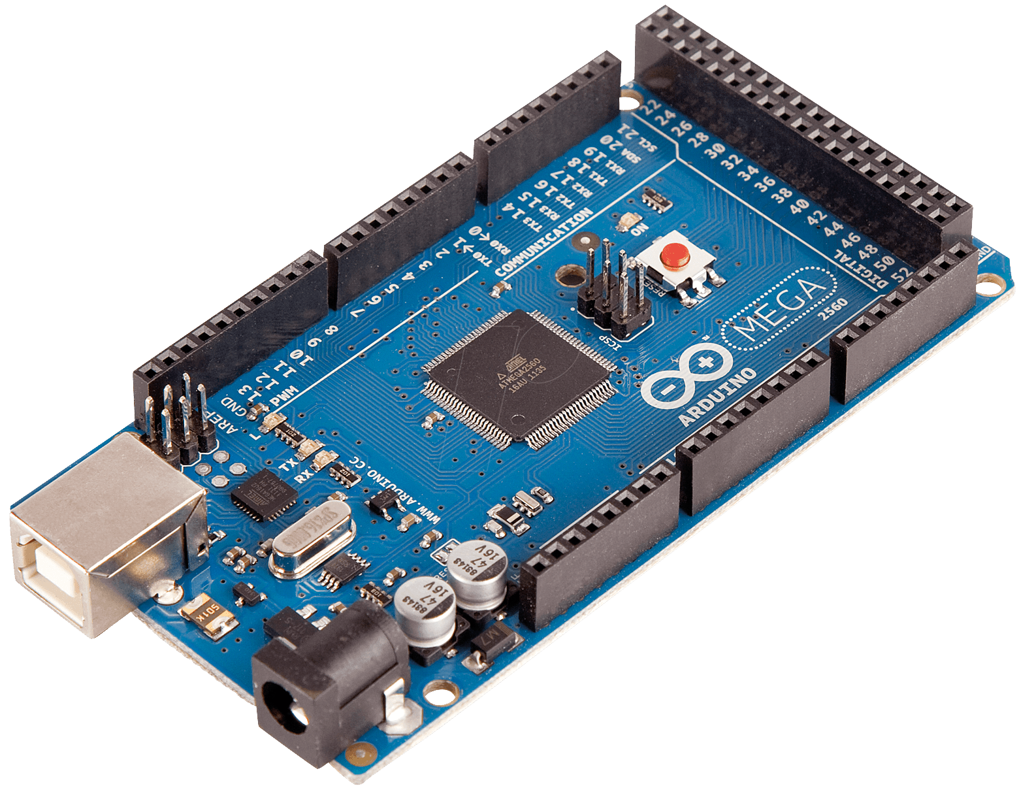
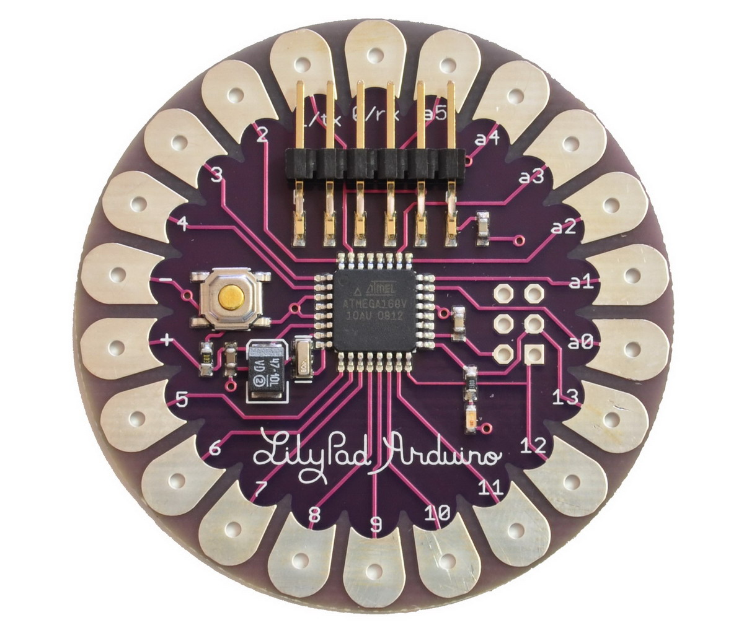
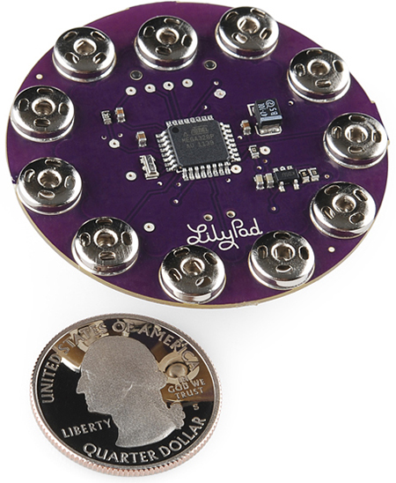
The Arduino Family

Slide 7
Your Kits
$55 Vilros Ultimate Starter Kit
https://www.vilros.com/ultimate-starter-kit.html
$8 LED Strip
http://www.amazon.com/NulSom-NeoPixel-Rainbow-Stick-Arduino/dp/B00PTEP14W/ref=sr_1_1?ie=UTF8&qid=1452991973&sr=8-1&keywords=neopixel+stick
$3 20 pc. Capacitor Pack
http://www.dx.com/p/16v-1000uf-aluminum-motherboard-capacitors-20-piece-pack-127865#.V0IQv5MrJMM
50 Button Pack
https://www.amazon.com/gp/product/B00R17XUFC/ref=oh_aui_search_detailpage?ie=UTF8&psc=1

Slide 8
Breadboard
Where is C:19?

Slide 9
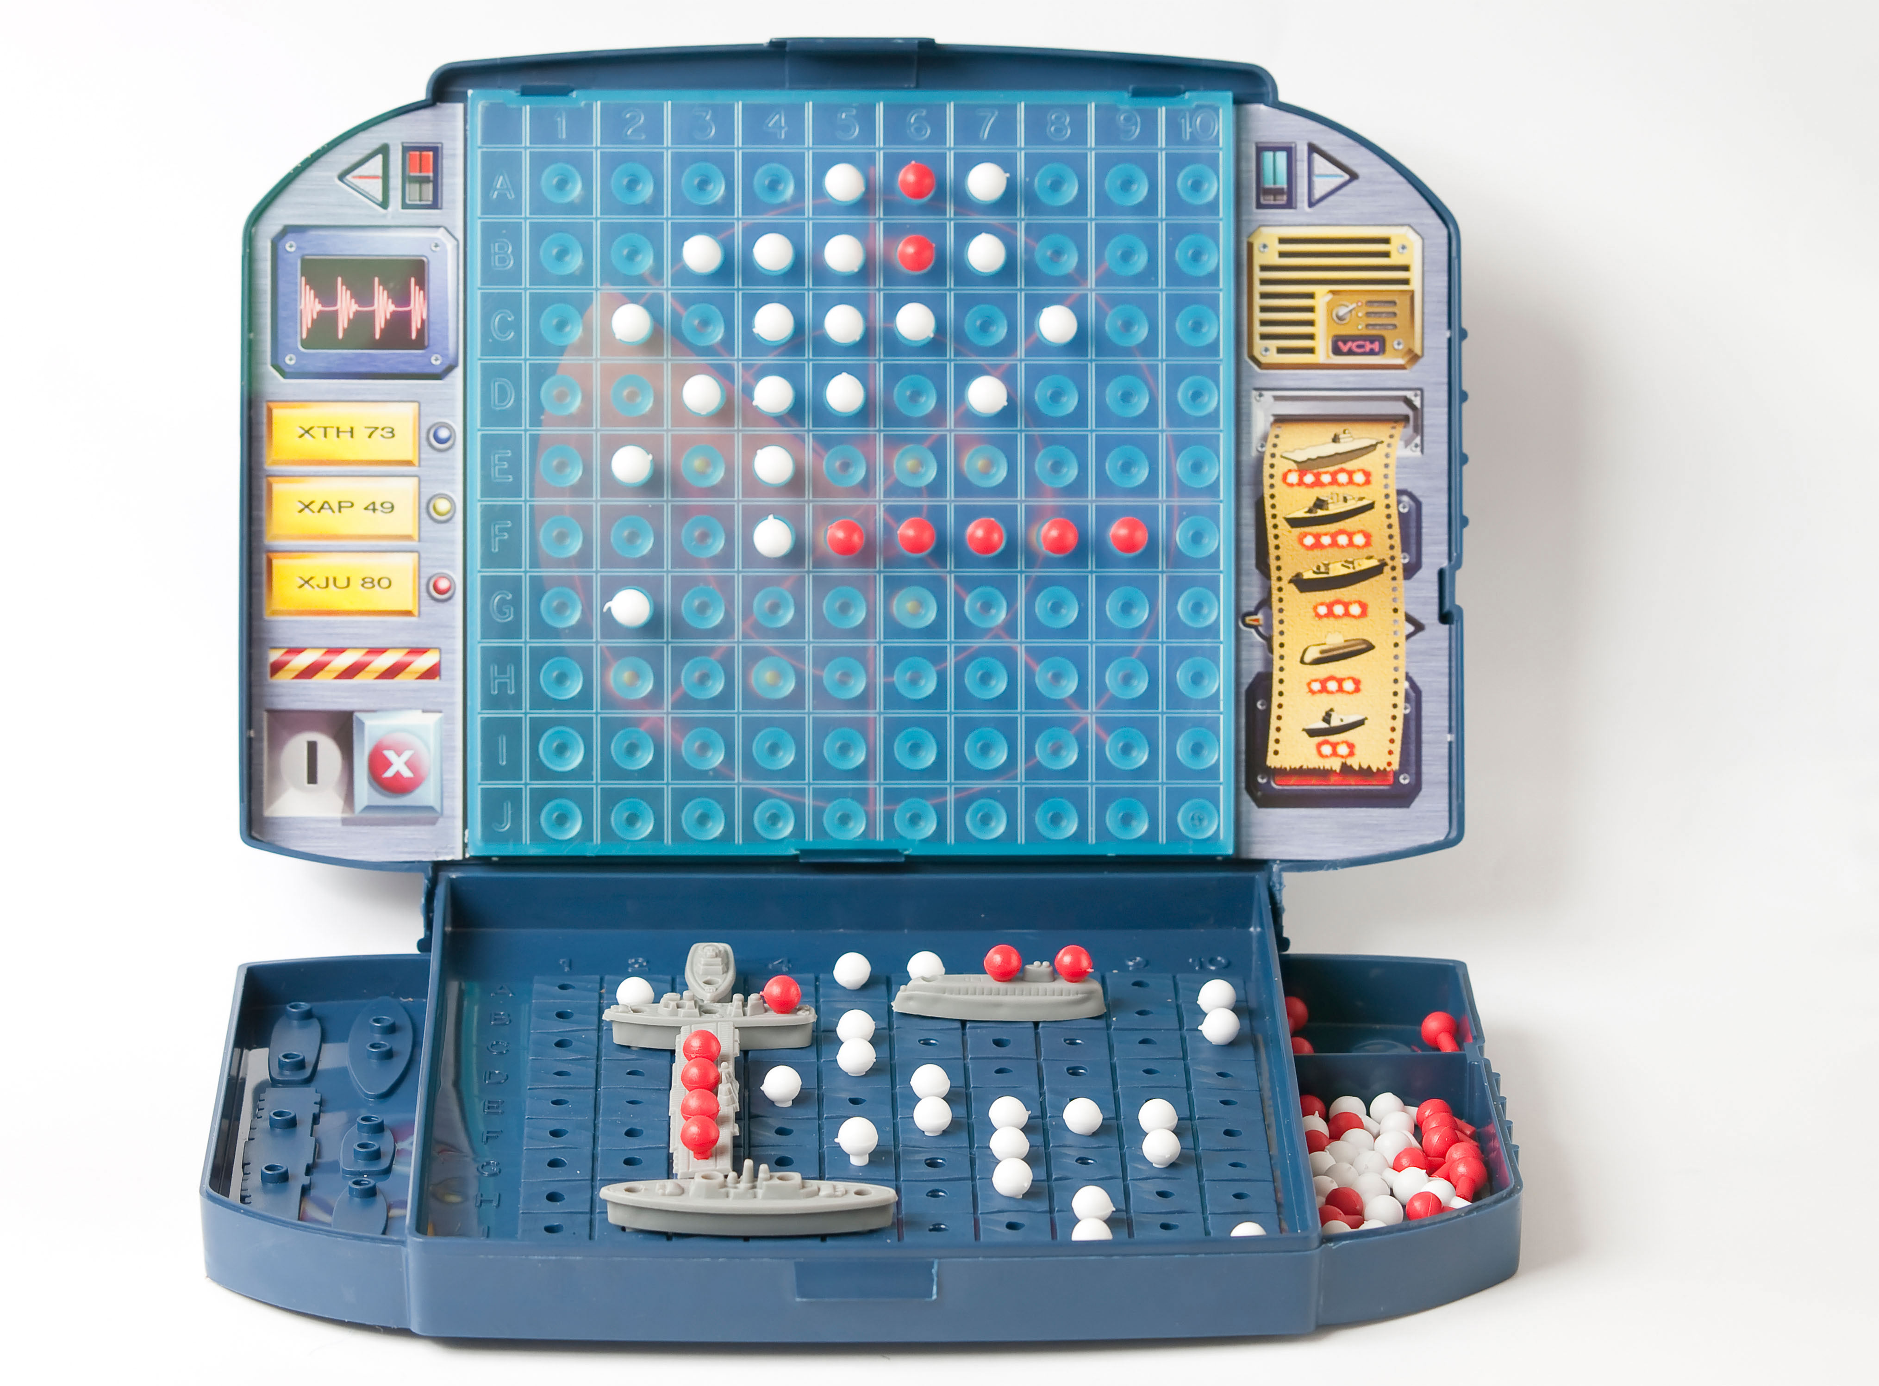
Just Like Battleship

Slide 10
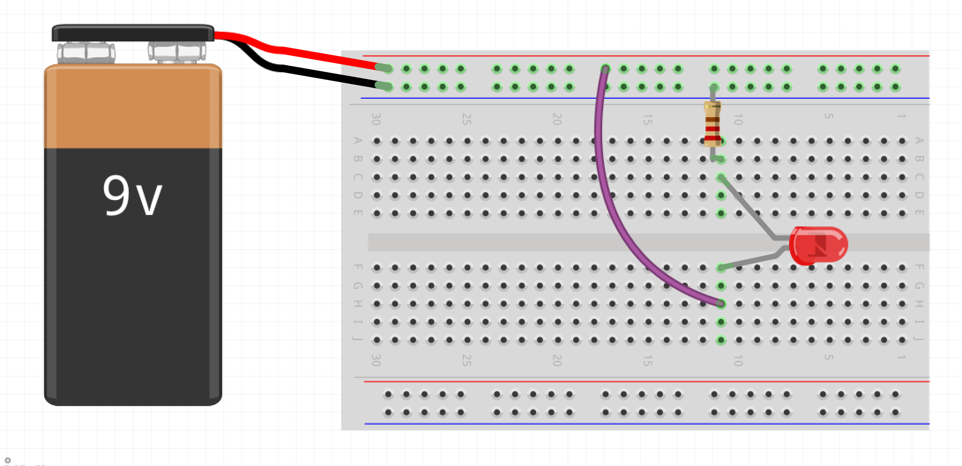
Wiring up a Circuit

Slide 11
Project Parts List
Arduino
Breadboard
USB Cable
1 Neo Pixel Strip with 8 LEDs
1 1000F Capacitor
1 10K Ohm resistor
3 Male-Female wires
12 Short Male-Male wires
4 small buttons (not the bigger ones)
1 Piezo Speaker

Slide 12
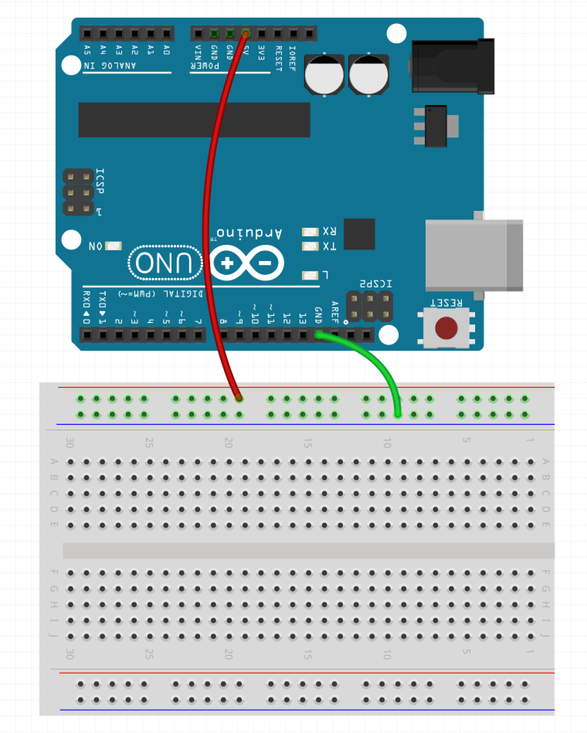
Step 1 – Wire up the Rails
Make sure the USB Cable is not plugged into the PC
Run wire from GND pin on Arduino to Blue Row on Breadboard (green wire in example)
Run wire from 5V pin on Arduino to Red Row on Breadboard (red wire in example)

Slide 13
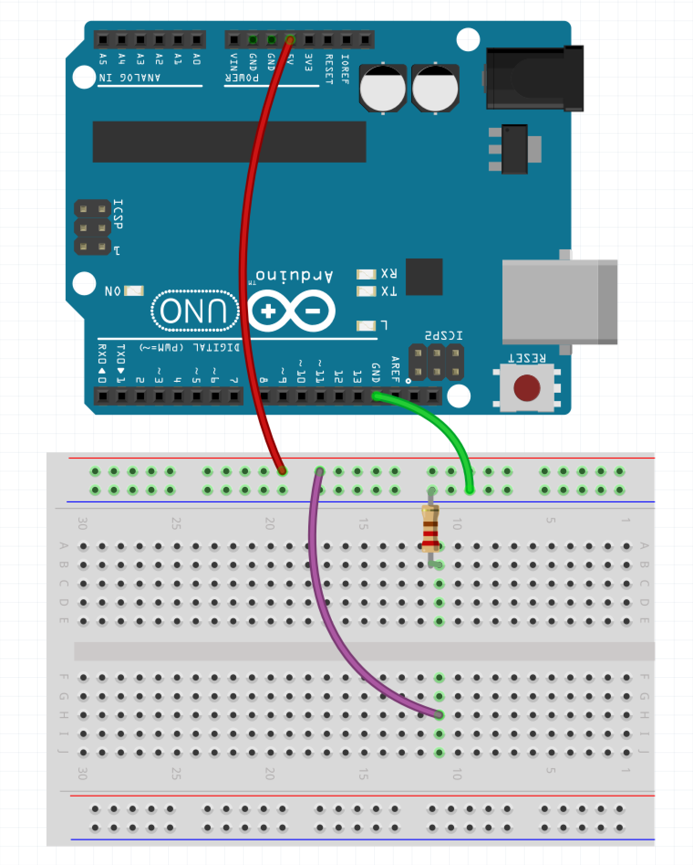
Step 2 – Place Resistor
Run wire from the red row to H:11 (purple wire in example)
Place one leg of resistor in the blue row and the other in B:11

Slide 14
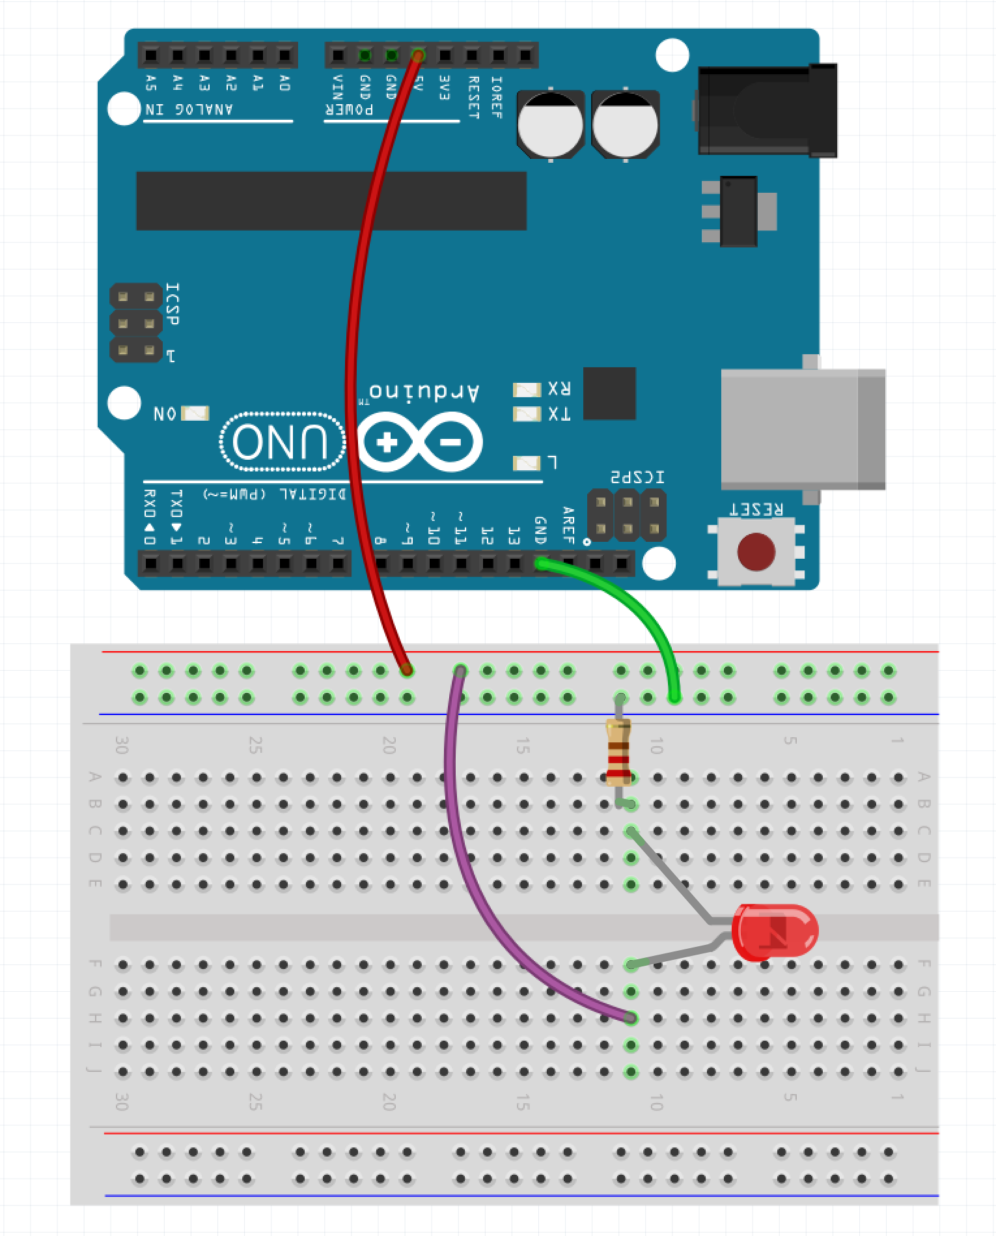
Step 3 – Place LED
Place the longer leg of the LED into F:11
Place the shorter leg of the LED into C:11

Slide 15
Step 4 – Apply Power
Plug the Arduino into the USB Cable
Plug the USB Cable into the PC

Slide 16
So What Just Happened?
Complete Circuit
Arduino acted like a battery
Resistor restricted current flow so LED isn’t damaged

Slide 17
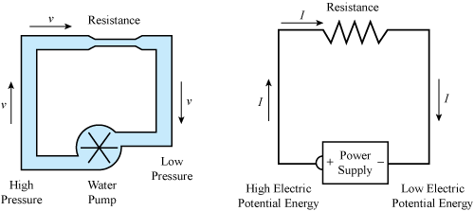
Water Analogy

Slide 18
LEDs

Slide 19
Why is one lead longer?

Slide 20
Project 2 Parts List
Arduino
Breadboard
USB Cable
1 330 Ohm resistor
1 LED
4 male-male wires
1 small button (not the bigger one)

Slide 21

Step 1 – Move the Wires
Make sure the USB Cable is not plugged into the PC
Move the wire plugged into the red row from H:11 on the breadboard to A:17 (purple wire in the example)
Add a wire that jumps from J:15 to J:11 (orange wire in example)

Slide 22

Step 2 – Place the Button
Place the button across the gap so that the pins are in E:17, E:15, F:17, and F:15

Slide 23
Step 3 – Apply Power
Plug the Arduino into the USB Cable
Plug the USB Cable into the PC

Slide 24
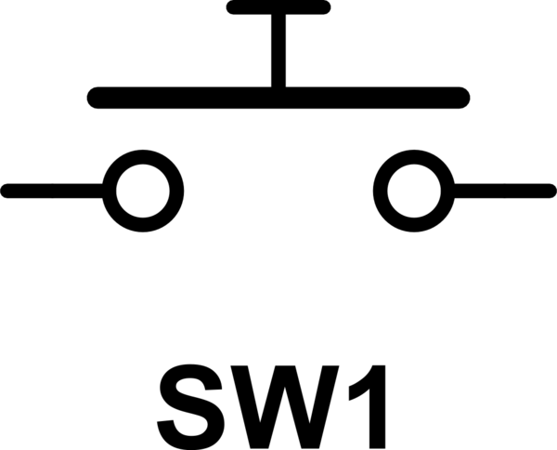
Button as a Switch

Slide 25
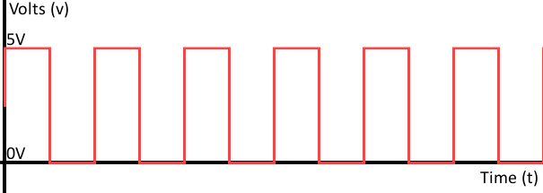
Project 3 - Let’s ’Read’ Something
The Arduino can ‘drive’ pins
The Arduino can also ‘read’ pins
Allows Arduino to ’read’ sensors, collect data, etc.
Need to program the Arduino to make it ‘smart’
The Arduino can set pins to HIGH or LOW
The Arduino can read pins as either HIGH or LOW

Slide 26
Project 3 Parts List
Arduino
Breadboard
USB Cable
1 DHT11 Humidity / Temperature Sensor
3 Male-Male wires

Slide 27
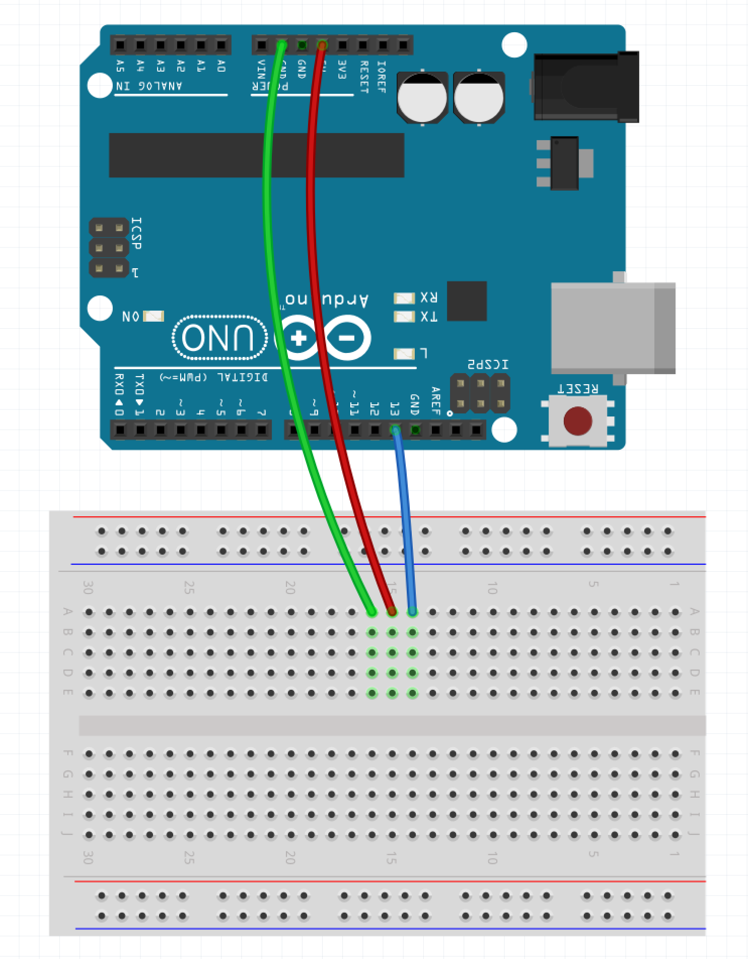
Step 1 - Wiring
Make sure the USB Cable is not plugged into the PC
Place a wire (green in example) from GND on the Arduino to A:16 on the board
Place a wire (red in example) from 5V on the Arduino to A:15 on the board
Place a wire (blue in example) from pin 13 on the Arduino to A:14 on the board
Place the DHT11 board directly into E:16, E:15, and E:14 so the blue part is facing away from the Arduino

Slide 28
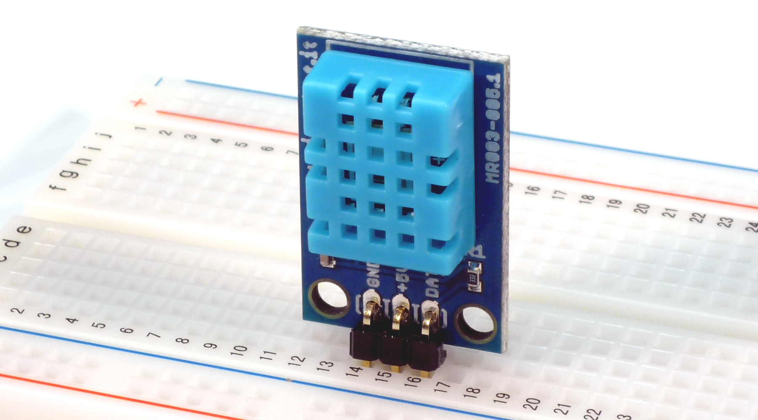
Step 2 – Part Placement
Place the DHT11 board directly into E:16, E:15, and E:14 so the blue part is facing away from the Arduino towards you – similar to the image below

Slide 29
Step 3 – Power the Arduino
Plug the Arduino into the USB Cable
Plug the USB Cable into the PC

Slide 30
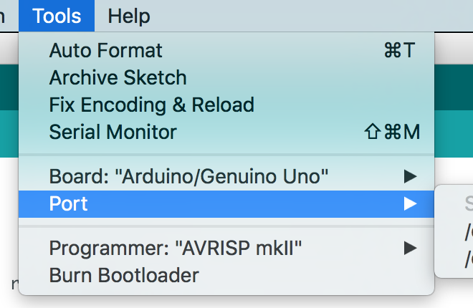
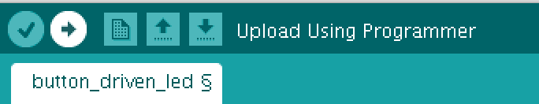
Step 4 – Program the Arduino
Plug the board into the PC via the USB plug
Open Sketch dht11.ino in the dht11_example directory/folder
Select Tools -> Port
Click the Upload Button

Slide 31
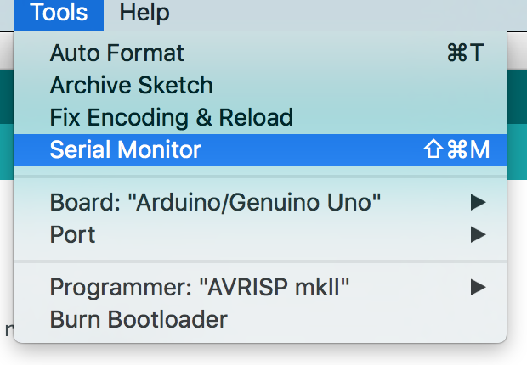
Step 5 – Open the Serial Monitor
Go to Tools and select ‘Serial Monitor’

Slide 32
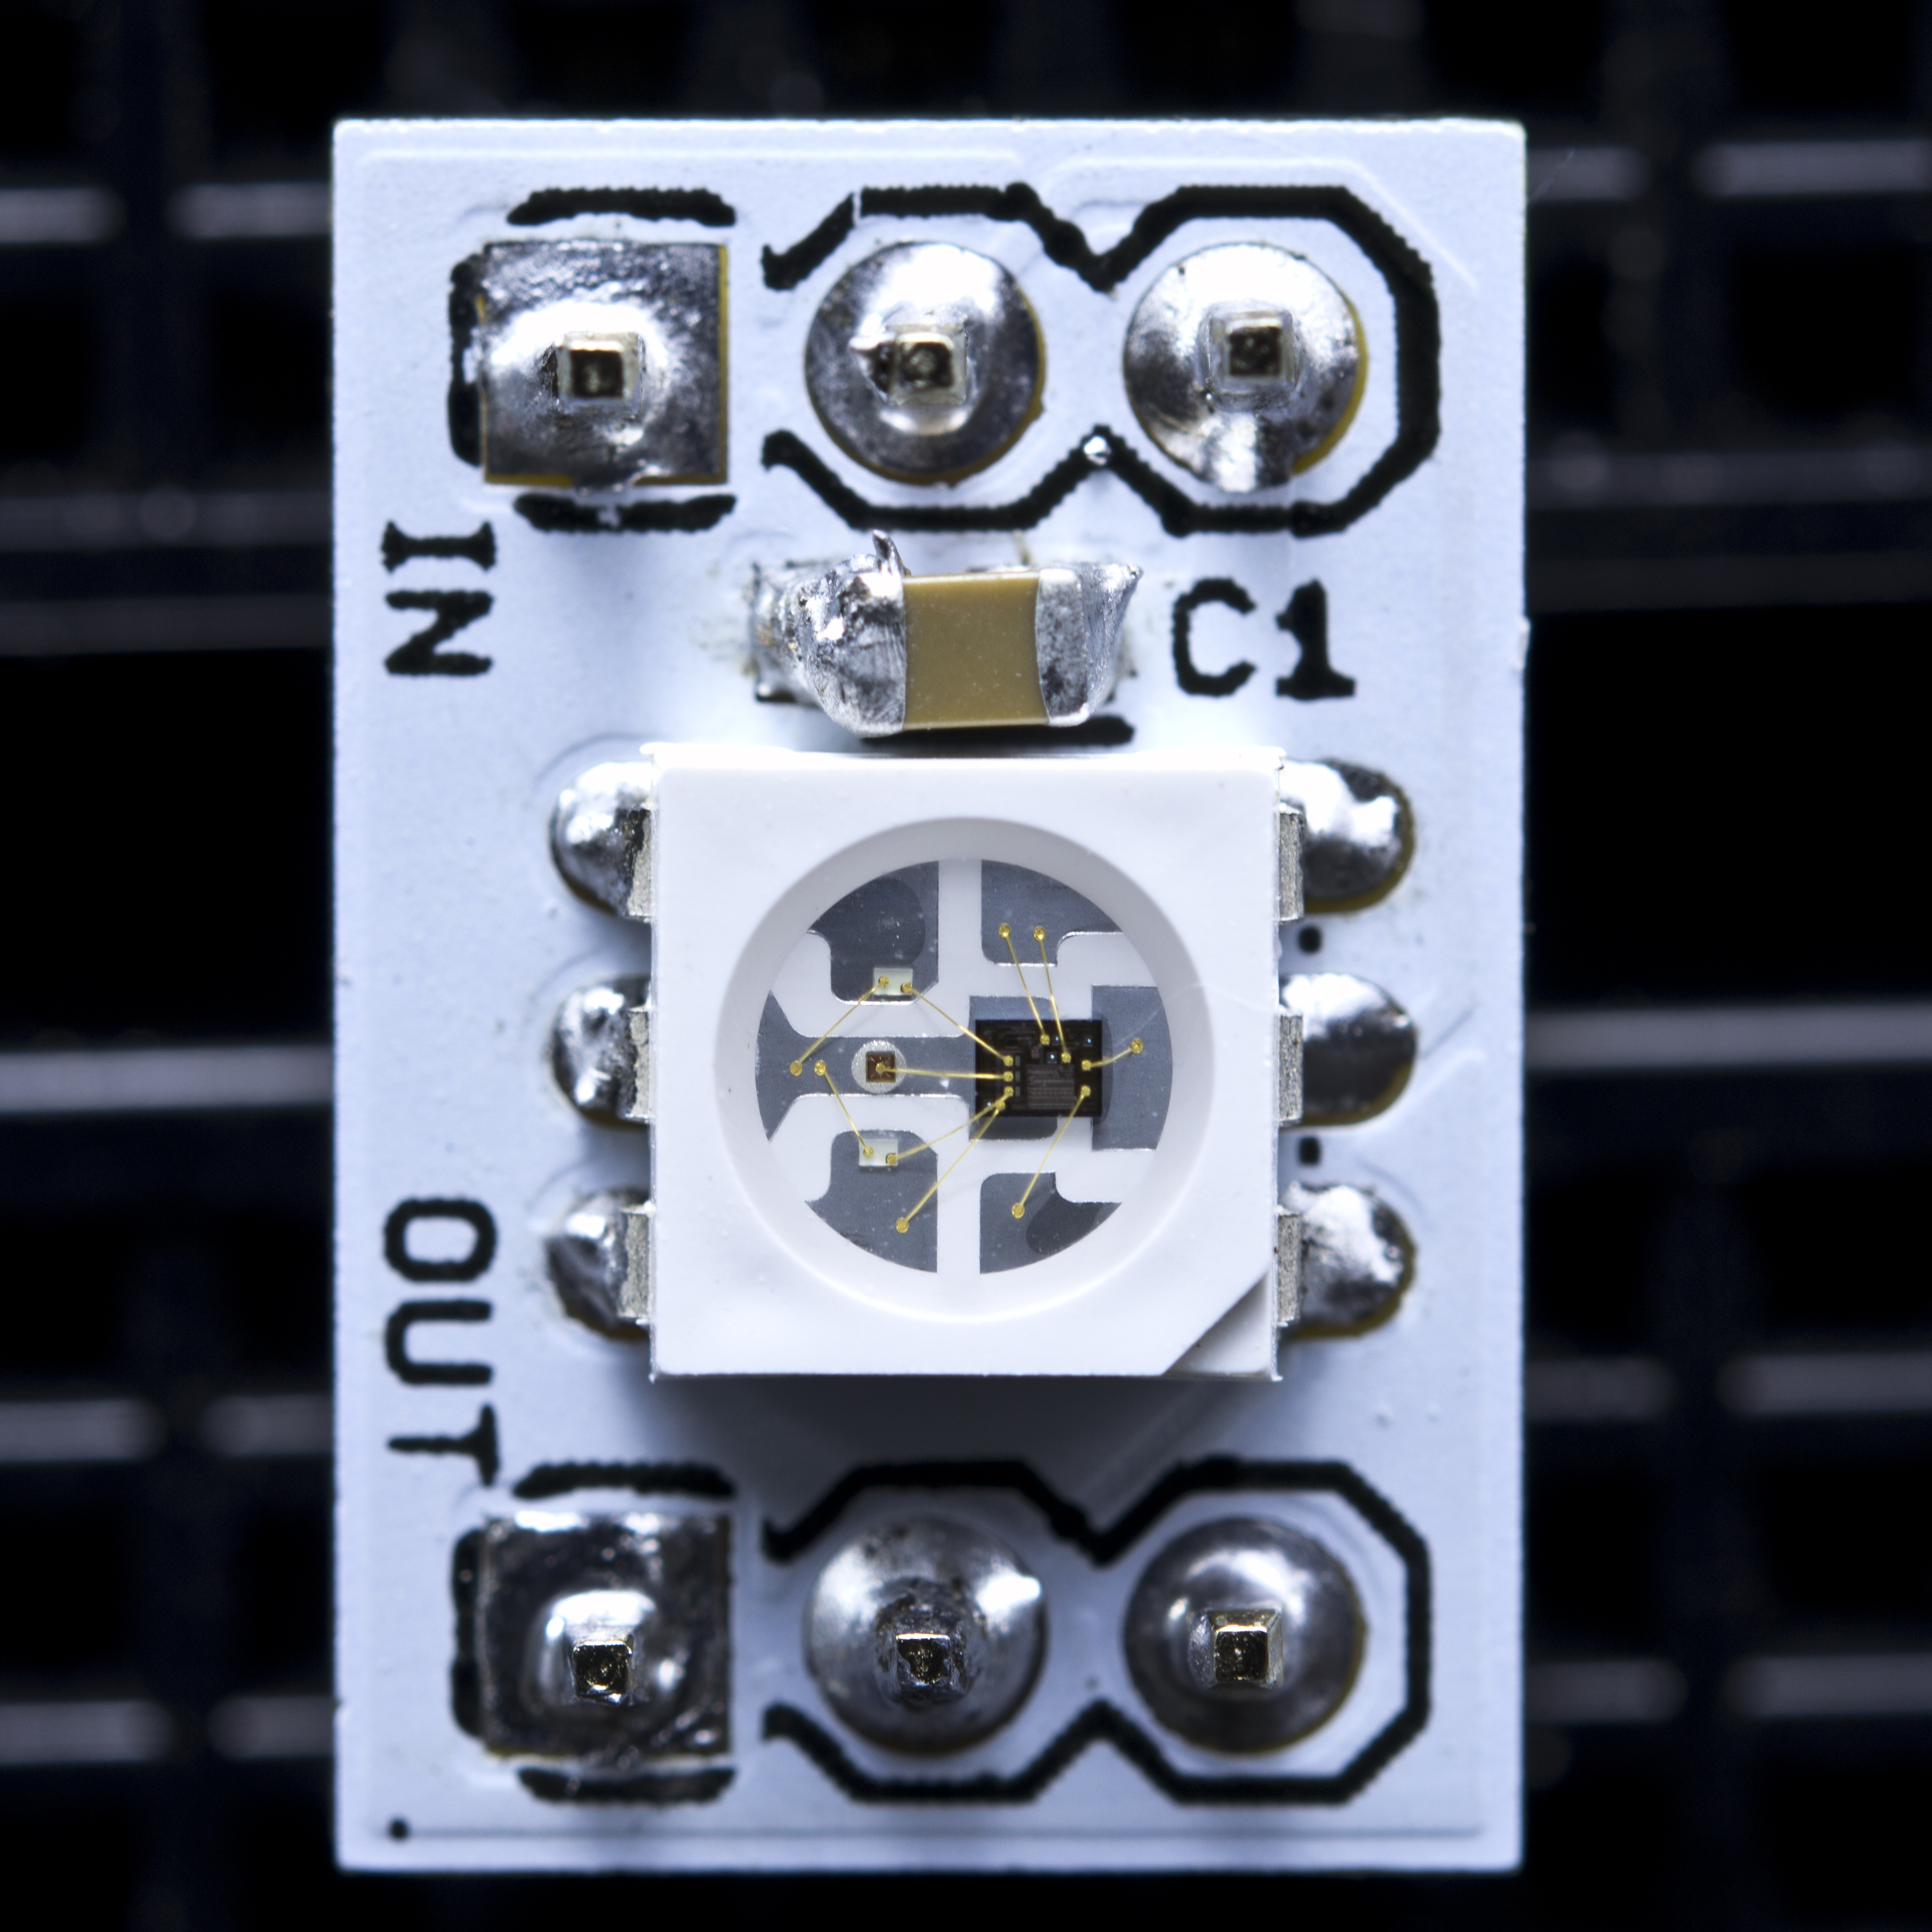
WS2811

Slide 33
Project 4 Parts List
Arduino
Breadboard
USB Cable
1 Neo Pixel Strip with 8 LEDs
1 1000F Capacitor
1 10K Ohm resistor
3 Male-Female wires
9 Male-Male wires
3 small buttons (not the bigger ones)

Slide 34
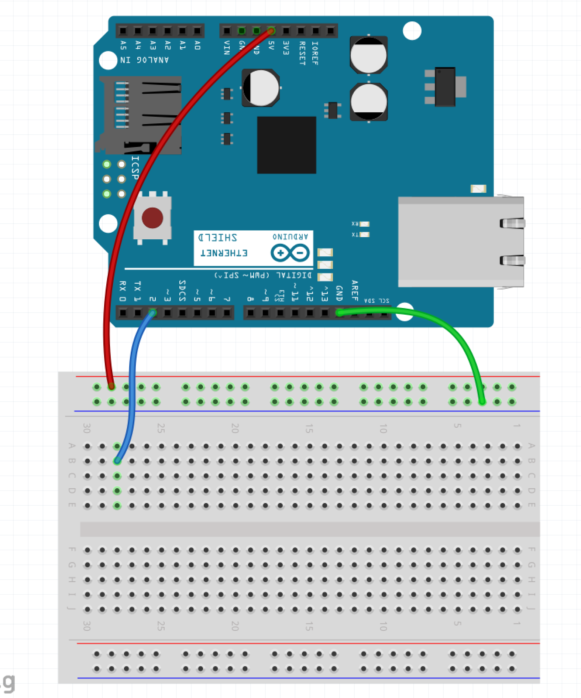
Step 1 – Wire the Rails
Make sure the USB Cable is not plugged into the PC
Run a wire from GND pin on Arduino to blue row on breadboard (green wire in example)
Run a wire from 5V pin on Arduino to red row on breadboard (red wire in example)
Run a wire from pin 2 of the Arduino to B:28 (blue wire in example)

Slide 35
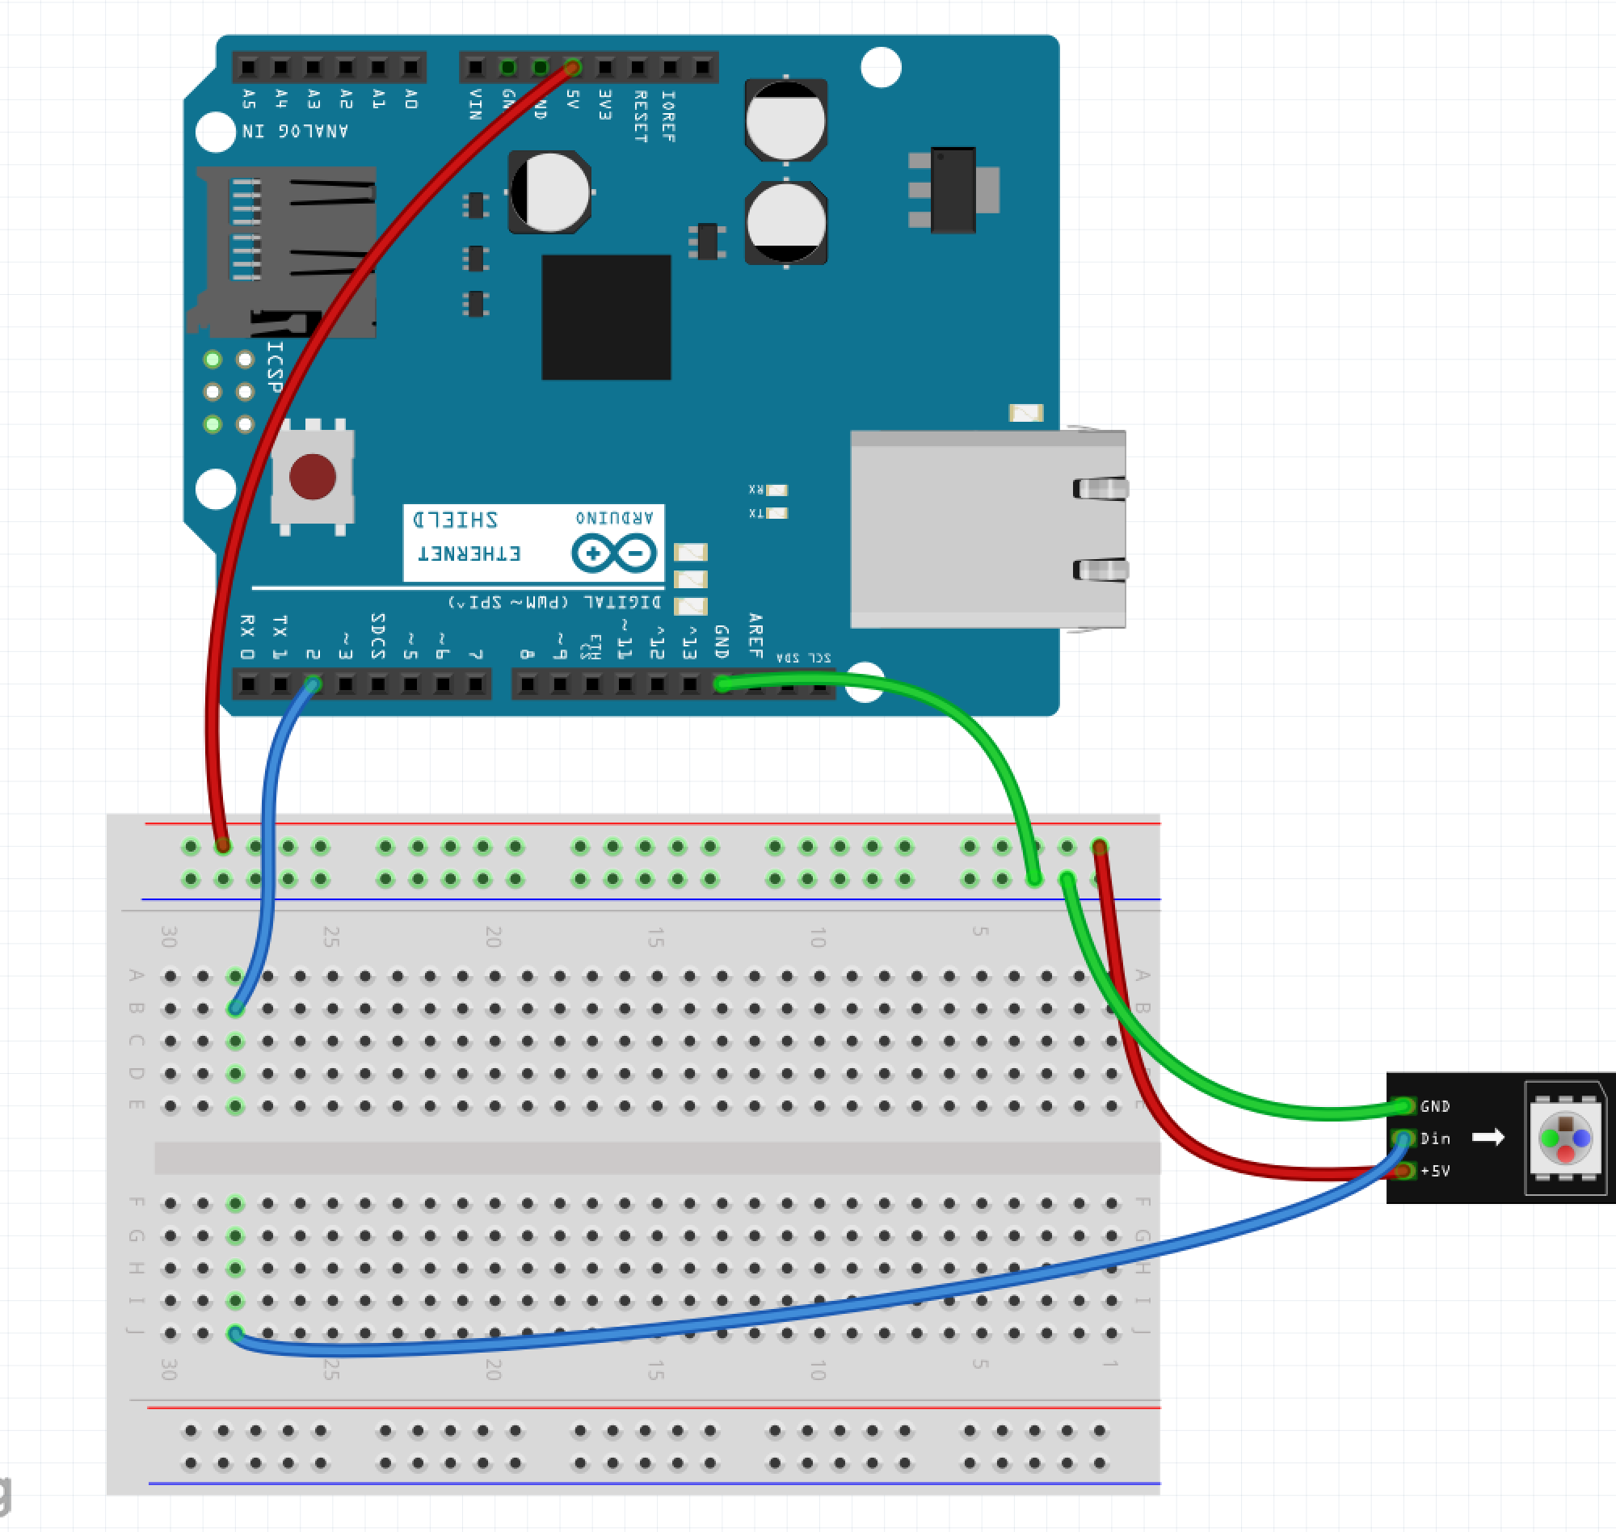
Step 2 – Wire the LED Strip
Run a wire from the Blue Row on breadboard to the GND pin of the LED strip (green wire in example)
Run a wire from the Red Row on breadboard to the 5V pin of the LED strip (red wire in example)
Run a wire from J:28 to the DIn pin of the LED strip (blue wire in example)

Slide 36
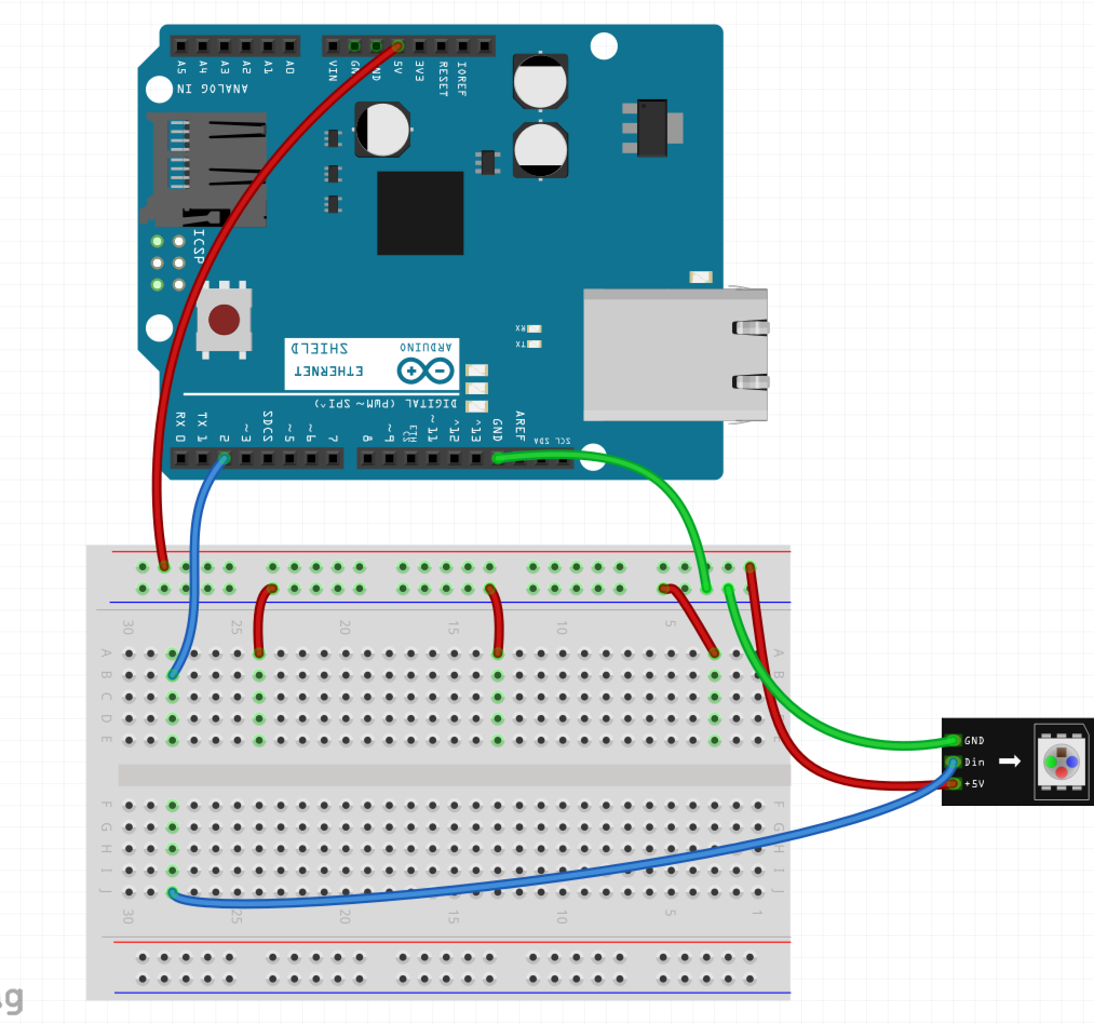
Step 3 – Wire One Side of Button
Run a wire from the Blue Row on breadboard to A:24
Run a wire from the Blue Row on breadboard to A:13
Run a wire from the Blue Row on breadboard to A:3

Slide 37

Step 4 – Wire Other Side of Button
Run a wire from pin 7 of the Arudino to A:22
Run a wire from pin 10 of the Arudino to A:15
Run a wire from pin 12 of the Arudino to A:5

Slide 38
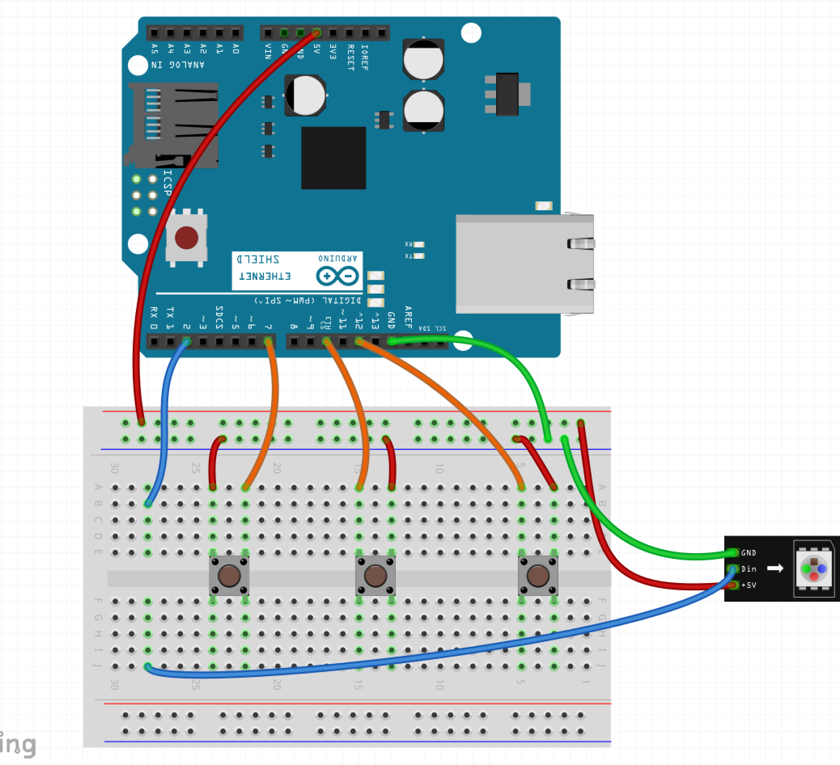
Step 5 – Button Placement
Place the 3 buttons across the gap
One in E:24 and E:22
One in E:15 and E:13
One in E:5 and E:3

Slide 39
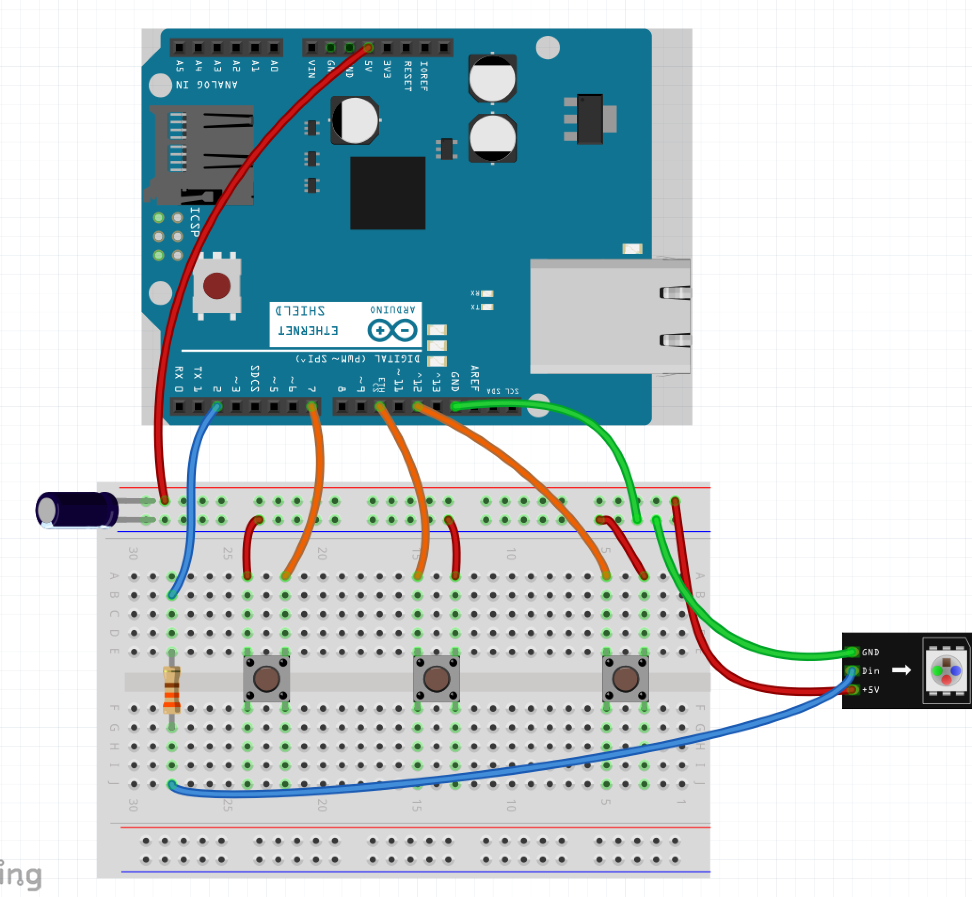
Step 6 – Components
Place the Resistor over the gap on E:28 and G:28
Place the capacitor with the long leg in the Red Row and the short leg in the Blue Row

Slide 40
Step 7 – Power the Arduino
Plug the Arduino into the USB Cable
Plug the USB Cable into the PC

Slide 41
Step 8 – Program the Arduino
Open Sketch button_driven_led.ino in the button_drive_led directory/folder
Select Tools -> Port
Click the Upload Button

Slide 42
What Next?
Guided Learning in Kits / Books
Online Tools
Spark Fun - https://www.sparkfun.com/
What you can do when you got it all down: https://youtu.be/ahpPqD7Ju5w?t=17s

